Slide 1

Governance as Code
A Software Engineering Approach to the 3-Lines-of-Defense in a Bank

Slide 2

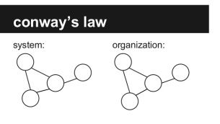
Problem Statement
Governance in Banks and other highly regulated industries, is hard:
Complex
Time Consuming
Expensive
Full of Toil (perceived as non-value added work)
Simple Changes or Approvals take forever
Since a Bank itself is a complex Organization, and if you view Governance as one of many systems within that Organization, Conway’s Law will apply and helps us understand the complexity.
“Organizations, who design systems, are constrained to produce designs which are copies of the communication structures of these organizations”

Slide 3
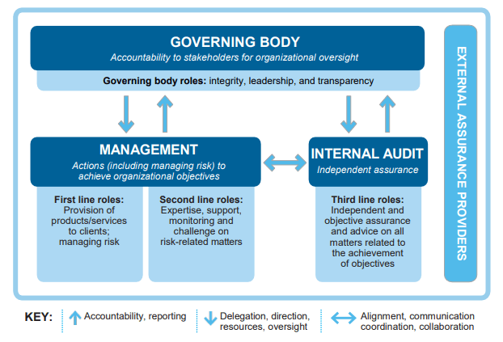
Complexity and The 3 Lines of Defense
Most Banks are setup with a Risk and Governance Model based on the 3 Lines of Defense. To understand the Complexity of Governance you need to understand the Model:
First Line of Defense: Business and process owners
Second Line of Defense: Risk Management and Compliance
Third Line of Defense: Internal Audit
IT Controls, Security, Management, and Operations all work within this Model and require auditable processes and immutable artifacts to provide assurance that the appropriate level of risk mitigation is in place.
Designing and executing the processes and managing the artifacts can be extremely time consuming; as well as running periodic Control Reviews with each line of Defense and Regulators. This simply does not scale well in the world of Cloud Native Delivery (Microservices Architecture & API First Development).

Slide 4

Software Engineering Approach to Governance
Treat it “as code”
Since its impossible to break Conway’s Law, the only viable approach to scale Governance in the world of Cloud Native is to treat it the same way you treat your source code.
Governance as Code can be defined as an opinionated ideal Governance “state” which can be described declaratively; within a JSON or YMAL file for example.
Each of 3 Lines of Defense can see benefits of taking this approach:
First Line of Defense: Governance simply becomes part of the existing Development and Change Management Processes
Second Line of Defense: Risk Management and Compliance reviews and challenges can happen in real-time
Third Line of Defense: Audits simply become Change Management exercises to review Risks associated with any deviation from the Ideal State.

Slide 5
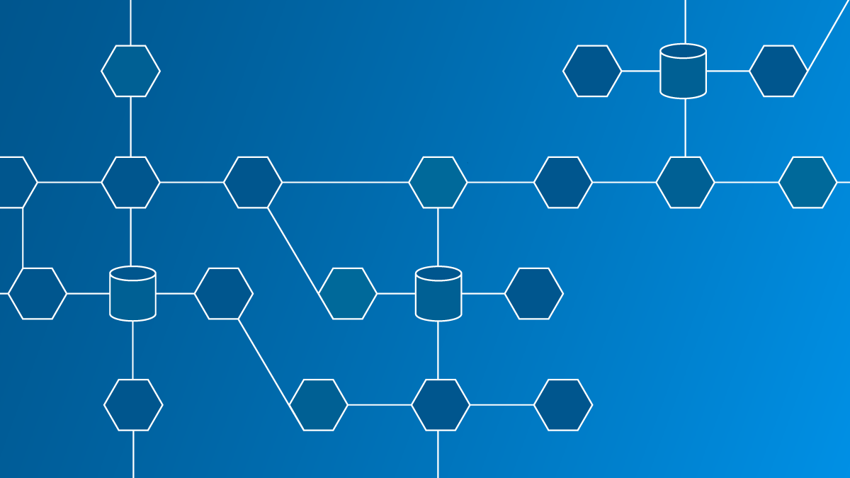
Governance as Code Demo
The Demo will show a very practical use case for how Governance as Code can work within the 3 Lines of Defense in a Bank.
It will be showing configuration changes to MTLS within a Service Mesh. This simple use cases includes related controls in several Industry Control Frameworks such as COBIT, NIST Cybersecurity Framework, and ISO 2700 Series and even demonstrates the Security concept of Zero Trust (secure everything with trusted identities).
All of the configurations within the Demo are Declarative and saved within a GitHub repo and immutable auditable artifacts are generated and can be reviewed on demand when required.

